Slide 1
CLass 2 Group 3
Q1: How is ALS differ from the SVD/SGD/common CFMF? (10)
Q5: One noteworthy point about spark ALS not included in the above questions. (5*4)
Ryan
Tim
Johnny
Cheef

Slide 2
Alternating Least Squares (ALS) v.s.
Stochastics gradient descent (SGD)
S
D
X
L
ALS:
two-step iterative optimization process
For iteration in range(max_iteration):
Fix user matrix U, find the optimum solution for item matrix V, such that the loss (MSE) would be minimized.
Fix item matrix V, find the optimum solution for user matrix M, such that the loss (MSE) would be minimized.
SGD:
Select a observed rating rij from R
Find out the corresponding ui and vj from our estimated matrix U and V
Update the estimator matrix U and V by the scaled gradient of loss

Slide 3
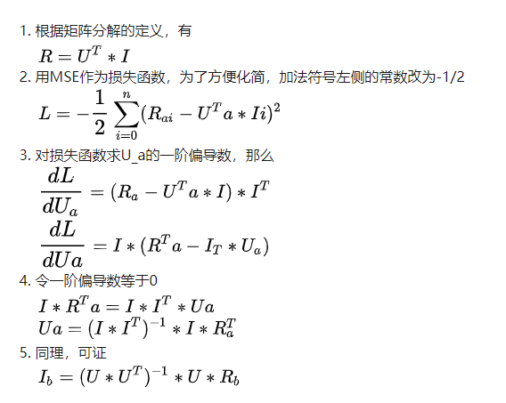
S
D
X
L
ALS:
假设用户为a，物品为b，评分矩阵为R(m, n)，可分解为用户矩阵U(k, m)和物品矩阵I(k, n)，其中m, n, k代表矩阵的维度。小段数学公式低能预警：

Slide 4
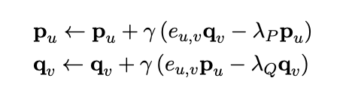

Pseudocode for SGD updating rule
S
D
X
L
wh

Slide 5
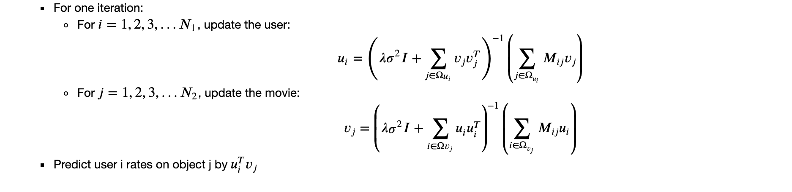
Pseudocode for ALS updating rule

Slide 6
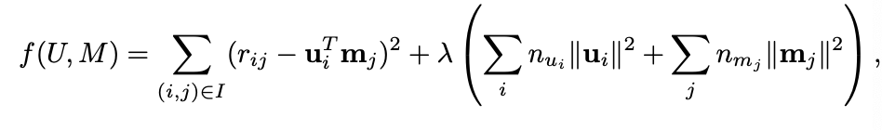
ALS with weighted regularization
Problem:
Without regularization term, ALS might lead to overfit
Solution:
Introduce a scaled λ penalty and the loss function becomes
λ-

Slide 7
Advantages of ALS
Easy for parallel computing
When dealing with implicit datasets, which are usually not sparse, SGD is not practical (users times items can easily be in the order of billions). ALS is a much more efficient optimization technique in these cases.

